Slide 1
A Comparative Study of GPS and Bluetooth Speed Data on Man O War Boulevard
Jacob Brashear

Slide 2
What I Proposed
Develop a process to format GPS data to corridor-level speeds comparable to Bluetooth data
Come up with a quicker way to calculate HERE Statistics than what is currently Implemented
Perform basic comparisons to see how the data are similar/different
Compare the strengths and weaknesses of the data collection methods and relate the findings to the speed data collected along Man O War

Slide 3
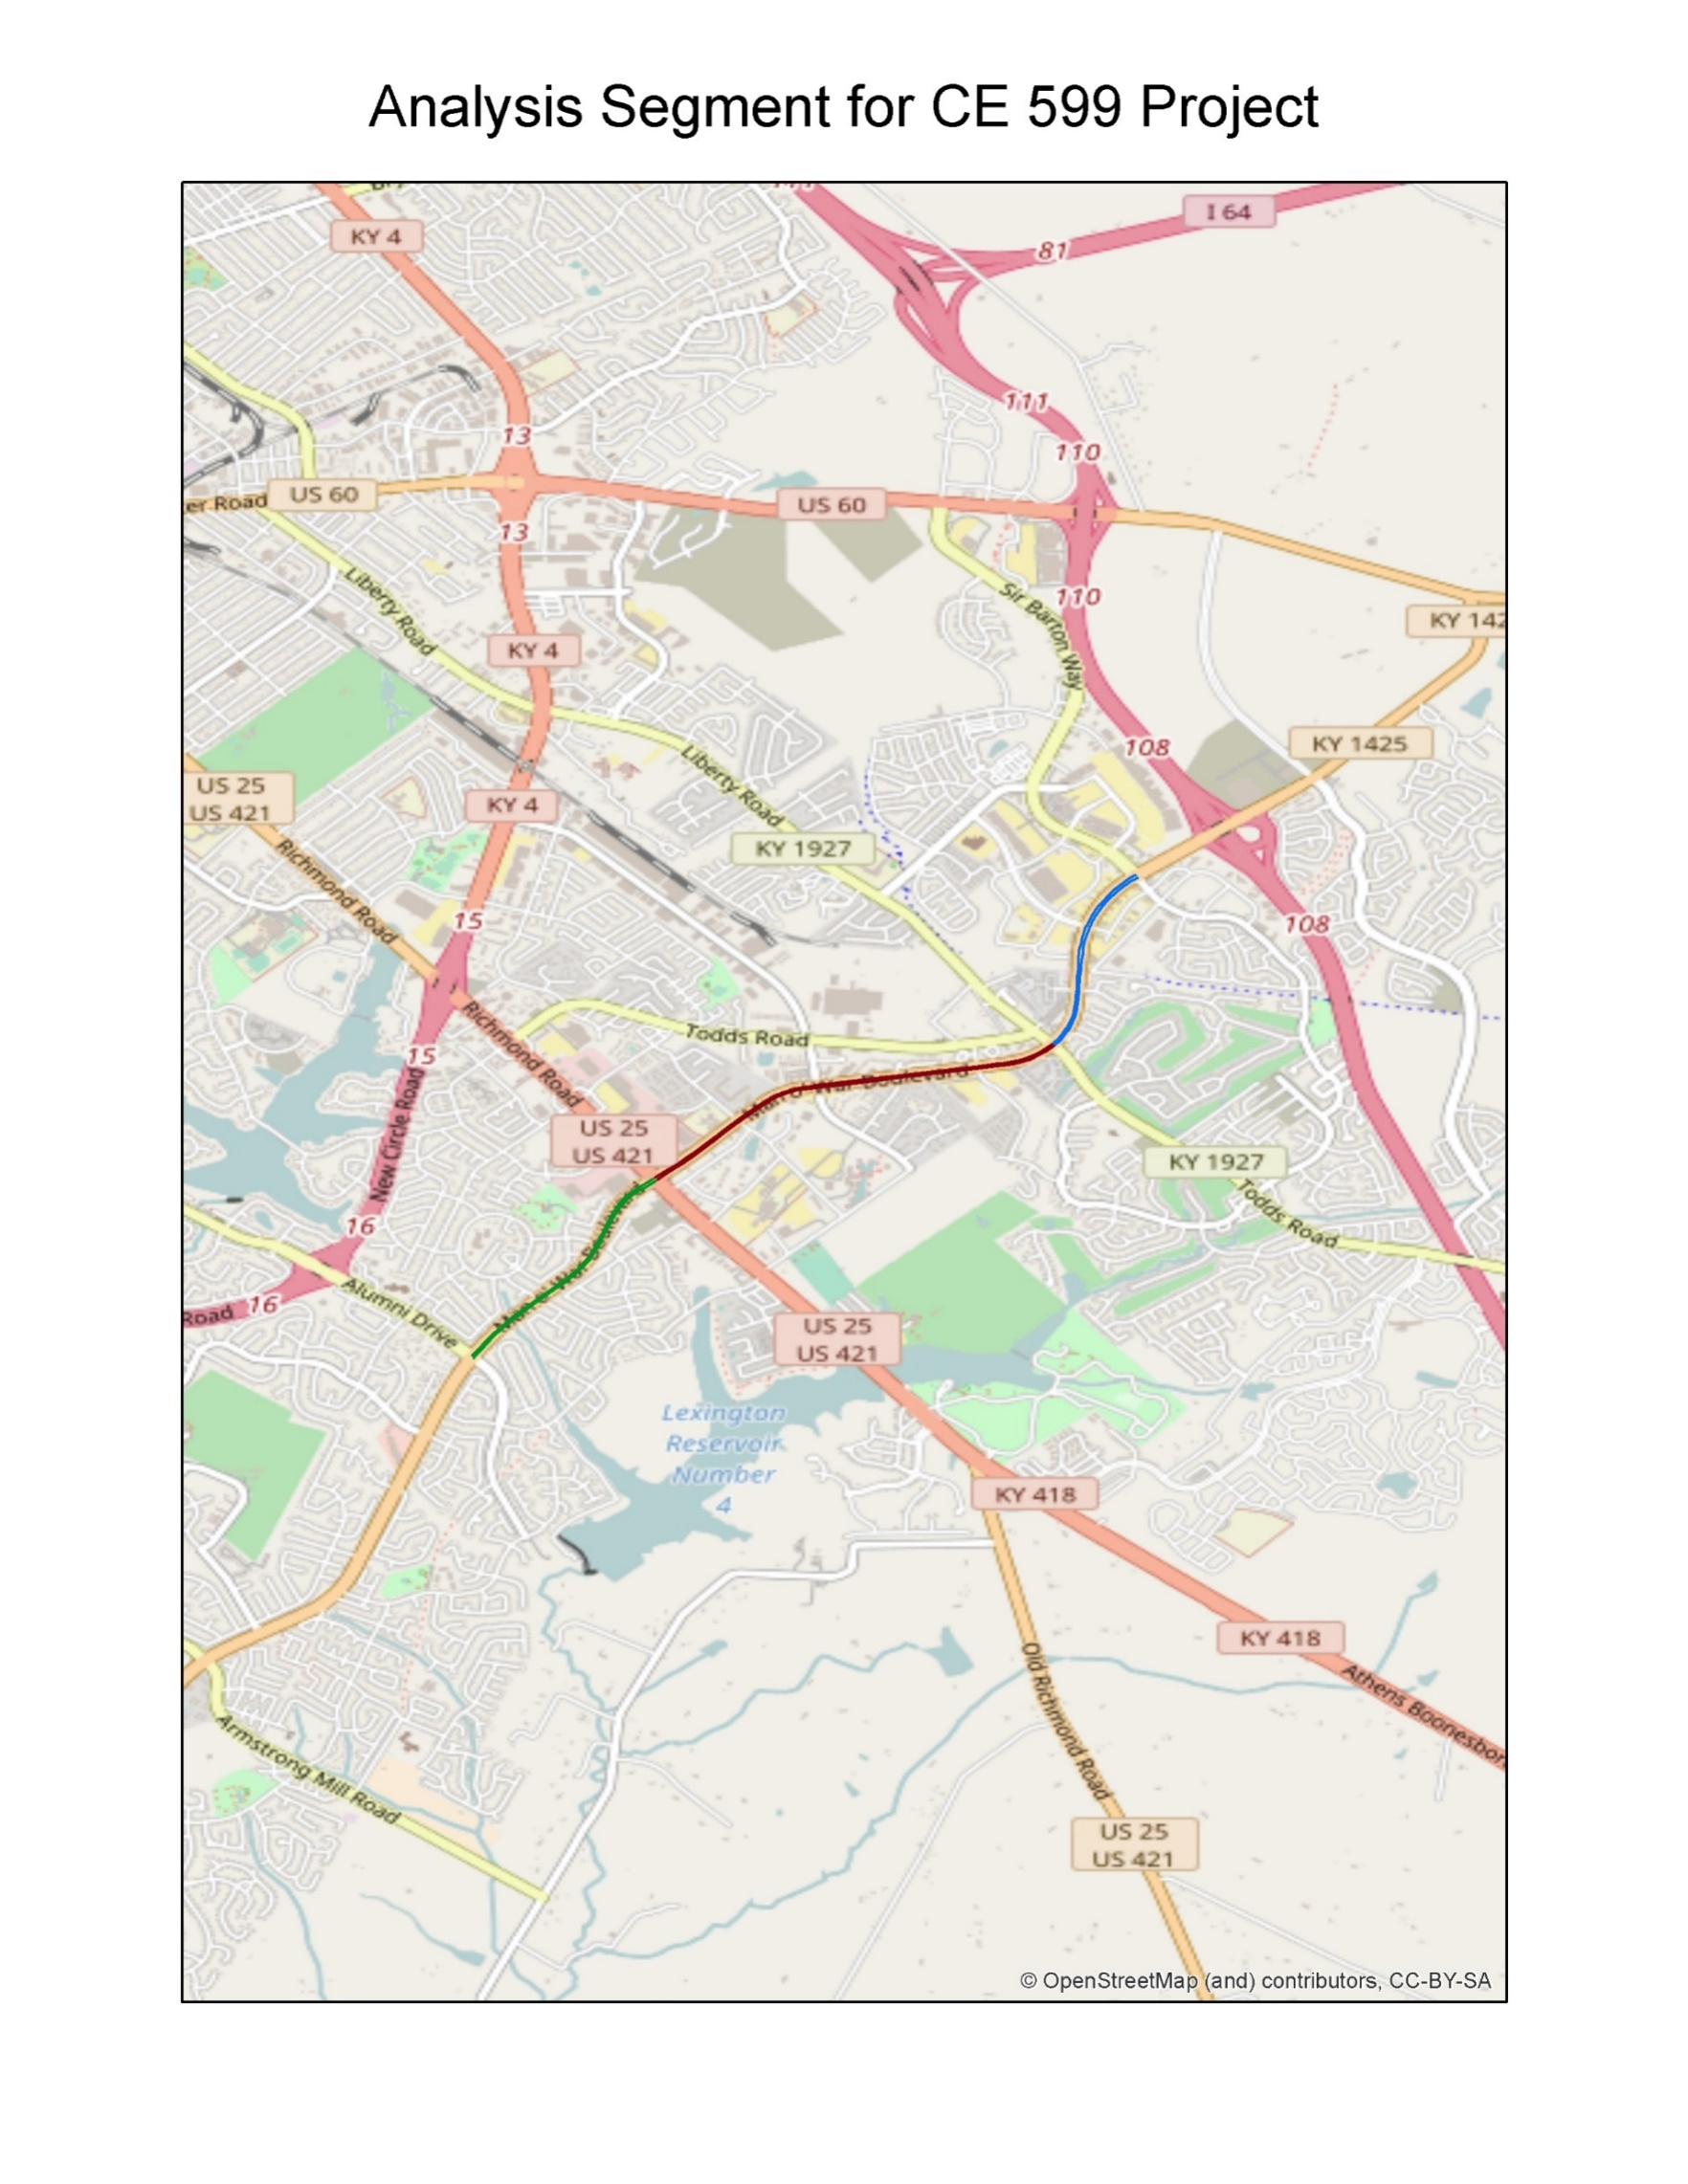

Slide 4
The Datasets
Year: 2015
Bluetooth: Gives 5-minute speed data along segments on Man O War Blvd (eg. Richmond road to Alumni Drive)
GPS: 5-Minute speed data along various links

Slide 5
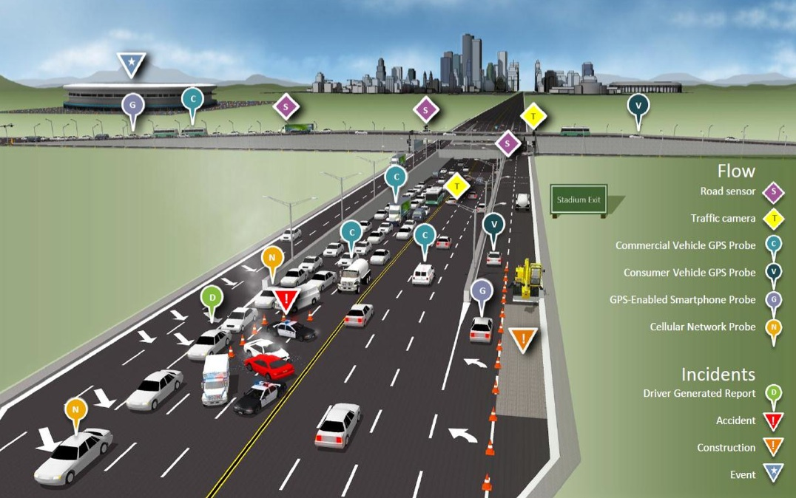
What are the Differences?
GPS: Uses GPS devices and smartphones to monitor speed
Great spatial coverage
Smith
Tends to record “Idle Speeds”

Slide 6
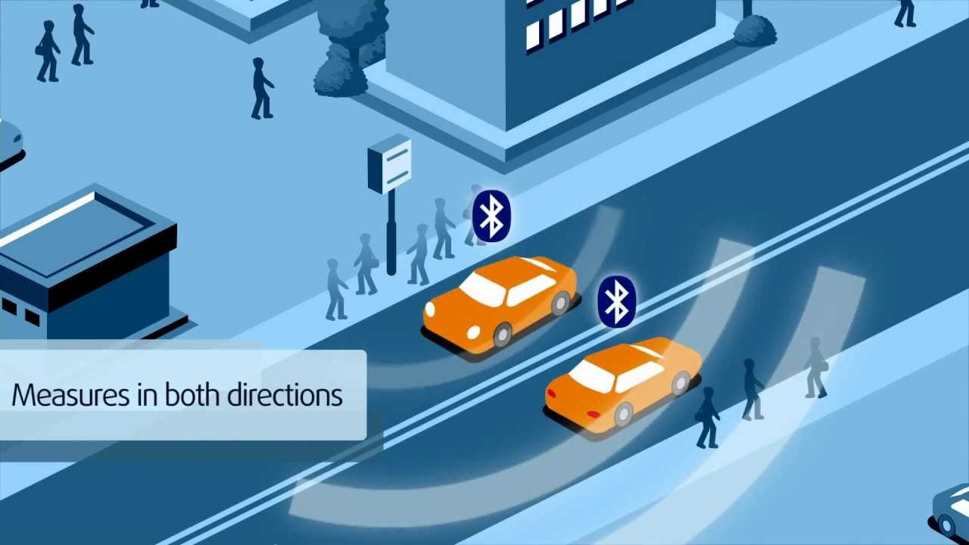
What are the Differences?
Bluetooth – Uses Bluetooth Sensors in phones and other devices to track and monitor traffic
Haghani et al. Introduced Bluetooth as a new “ground truth” by comparing Bluetooth travel time data to floating cars.
Smith
Eliminates idle speed records by forcing vehicles to pass between two points
500’ radius detection can cause issues when frontage roads exist.

Slide 7
Development of Datasets: Python and Excel
Research: “Analysis of Historical Travel Time Data” – Chen et al.
Performance metrics from this paper adapted into python code and calculated by link for HERE data and by segment for Bluetooth data
Used GIS to create tables containing HERE links by segment.
Used shapefile to create segment-level HERE stats by joining HERE Link statistics to GIS links.
Statistics were re-calculated on a weighted average with respect to HERE Link Lengths
Used excel to combine HERE Segment and Bluetooth Segment data for comparisons
Created Pairplots using Seaborn

Slide 8
Metrics from Chen et al.
Mean Speed
Standard Deviation
% Coverage
85th percentile speed
5th percentile speed
60th percentile speed
Travel Time Index (TTI)
Planning Time Index (PTI)
Buffer Index (BTI)
Pair plots between Mean and Epoch (5-min intervals)

Slide 9
Richmond Road to Alumni
Notes:
Pct Intervals for HERE is by link. Pct Intervals for Bluetooth is by segment
HERE 60th speed is calculated between 6AM and 8PM

Slide 10
Richmond Road to Alumni
Notes:
Notice how different PTI and BTI are between HERE and Bluetooth?

Slide 11
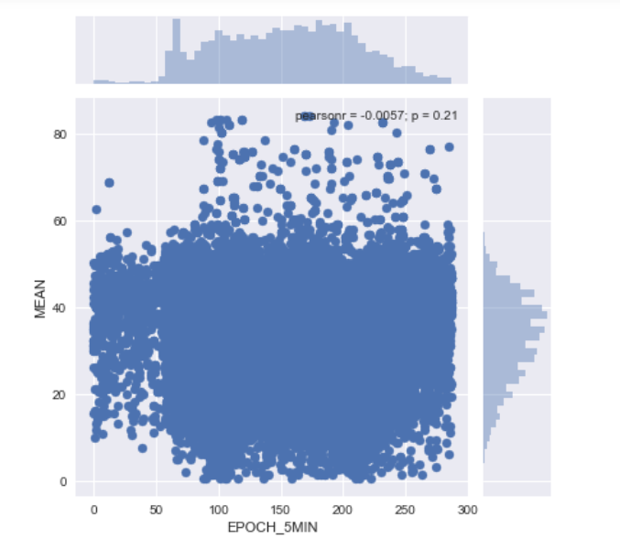
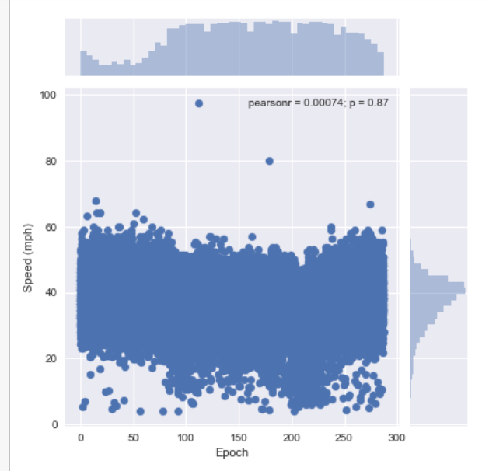
Pairplots: Richmond Road to Alumni
HERE: Weekday Non-Holiday
Bluetooth: Weekday Non-Holiday

Slide 12
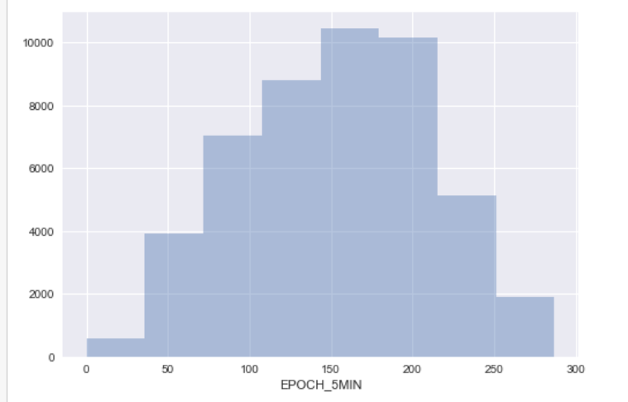
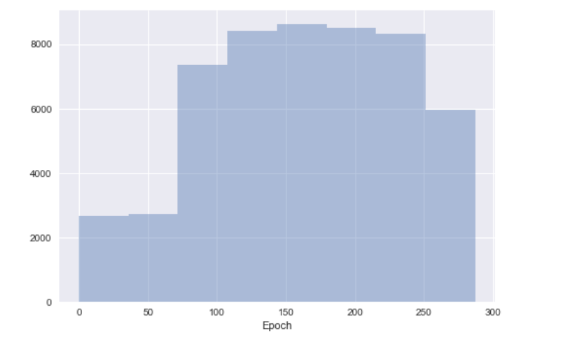
Pairplots: Richmond Road to Alumni
HERE: Weekday Non-Holiday
Bluetooth: Weekday Non-Holiday

Slide 13
Conclusions
Probe GPS data tends to show lower 5th percent speeds than Bluetooth Data.
Also leads to Higher PTI’s
Probe GPS Mean speed at times seems lower than Bluetooth speeds.
Alumni-Richmond
Richmond-Alumni
Richmond-Todds

Slide 14
Next Steps
Perform more detailed statistical analysis between the datasets
Modify code to handle larger datasets
Thesis Ideas:
Explore more detailed analysis of congestion at Work Zones using Probe GPS and Bluetooth Data
Consider data fusion between HERE and Bluetooth data for more robust datasets.

Slide 15


